Slide 1
Sales & Promotions Insights
Group 2: Sudarshan P Shreyashri V Athani
Site-link:
https://sites.google.com/view/ie-6600-proj-2-grp-2/introduction

Slide 2
Content
Introduction: Problem statements & Key objectives
Data: Source, Attributes & pre-processing
Key attributes : Understand the key attributes of the data
Visuals & Insights: charts, plots and Dashboard
Conclusion: Conclude and recommend

Slide 3
INTRODUCTION
-Retail promotions are powerful tools to drive sales and encourage customers to buy more.
-Promotions typically increase sales volume but come with the trade-off of reduced margins.

Slide 4
INTRODUCTION
For retailers and CPG companies, measuring promotion effectiveness is essential to:
Assess the impact on overall sales volume.
Understand the true effect on margins and profitability.
Evaluating these factors helps optimize future promotions for maximum impact.

Slide 5
Key objective
Optimize Promotion Spend Allocation
Measure Long-Term Impact on Brand Equity
Determine Optimal Promotion Frequency and Duration
Benchmark Against Competitors
Evaluate Cross-Category and Cross-Channel Synergies

Slide 6
Data
Correlation analysis
-Actual_avg_price & Avg_price
-Lift (Promo -level) & Promolift (%) (Promo level)
-Unit volume & Unit volume2 (Promo-level)
Redundant information
-TradeSpendTotal (Promo-level) has only 0 in all rows
-Outlier is has ‘N’ and ‘Y’

Slide 7
Data Profiling
Total Entries | Unique Products | Baseline Revenue | Product Categories | Promo Channels | Producers | Promotional Sales | Promo Type
134,907 | 2366 | $11,122M | 3 | 4 | 5 | $11,636M | 2
Transformation
- Convert year, month & date to datetime datatype
- Converting all numerical columns to Int datatype

Slide 8
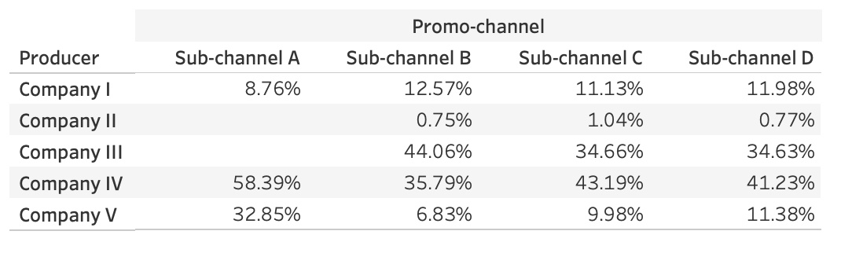
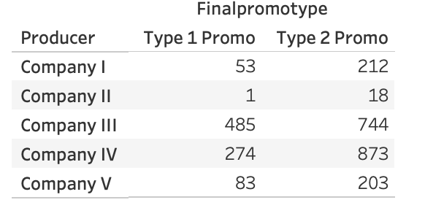
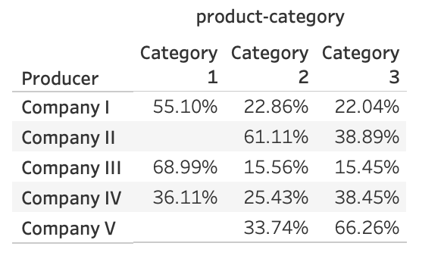

Slide 9
Key attributs
Value_Sales: Promotional sales from all products
Investment System: Total cost of running the promotion, including discounts and marketing expenses.
Producer: The brand or company manufacturing or supplying the product.
Sub Category: Specific segment within a broader product category.
Sub Channel: Distribution channel where the product is sold (e.g., online, in-store).
BLRev (Baseline Revenue): Expected revenue without promotional influence.

Slide 10
KPIs
IncProfit-System (Promo Level): Additional profit generated due to the promotion.
Actual Quantity (Promo Level): Number of units sold during the promotion.
ROI%System: Return on investment from the promotion
Promo Flag: Indicator (1/0) to show if a promotion is active during a specific period.
Promo Type: Type of promotion being run (e.g., discount, bundle, special offer).
Product_Brand_View_Name: Name of the product brand being promoted, used for brand-level analysis.

Slide 11
VISUALS AND INSIGHTS

Slide 12
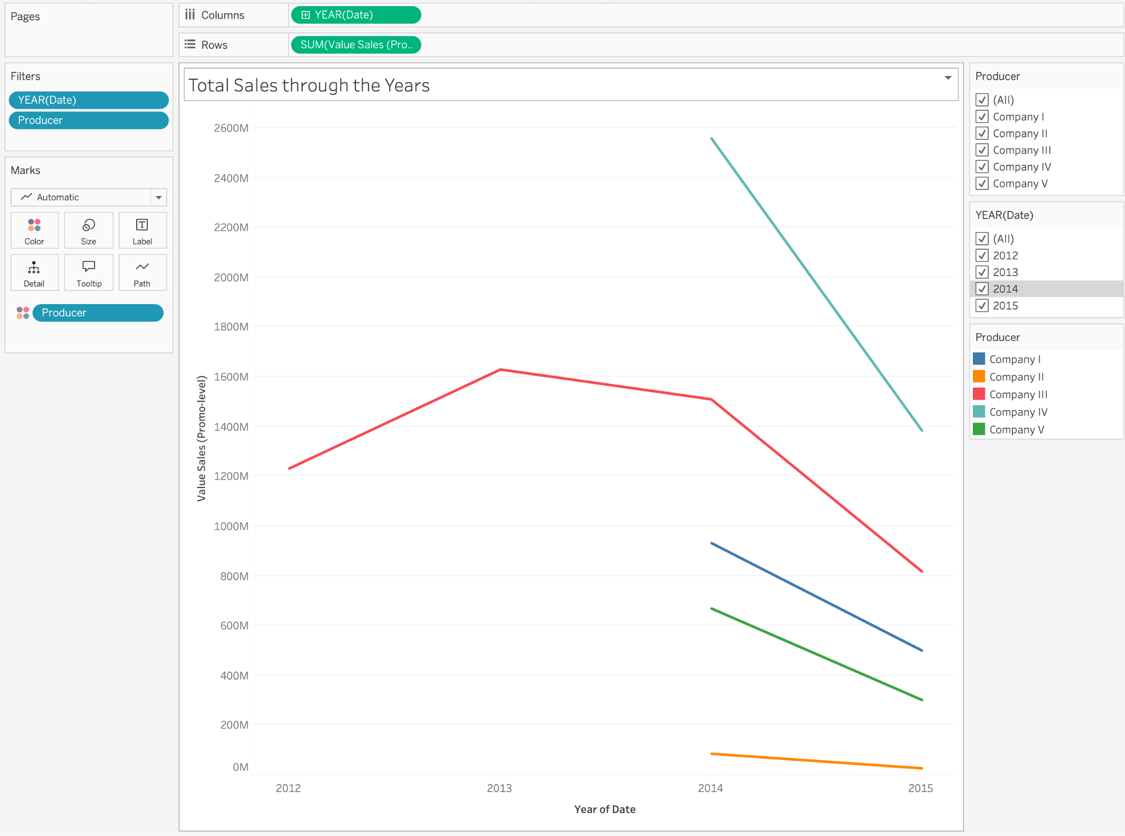
- We notice, that the data present in dataset has sales for company 3 from 2012 - 2015. Whereas for other companies
it is only for 2014 & 2015.
- So data is skewed and biased towards company 3.

Slide 13
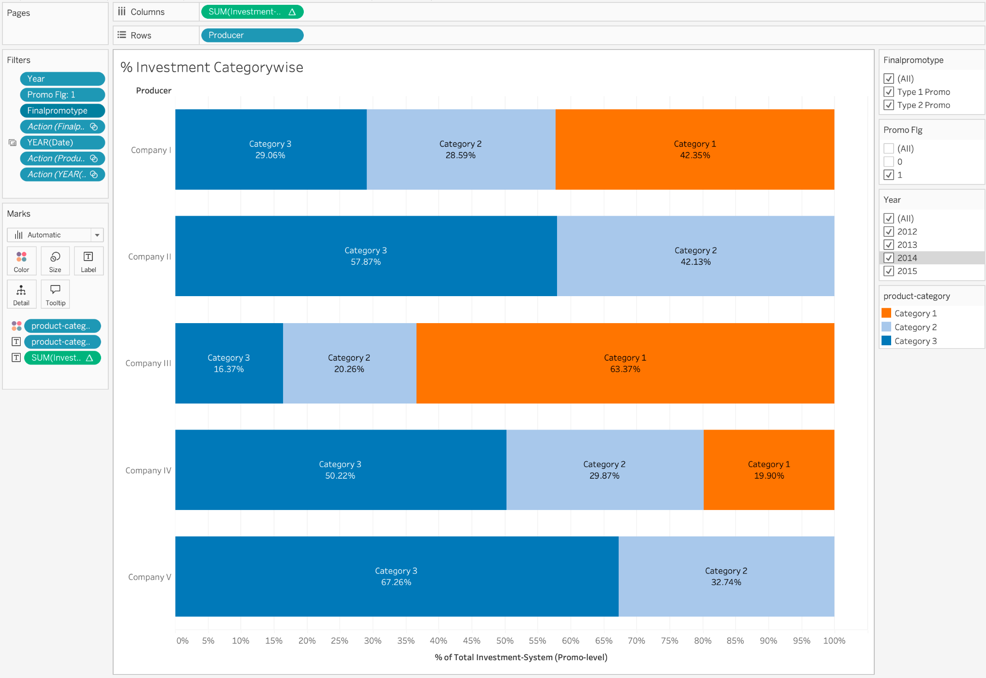
-Company 1 evenly invested in all the category
-Company 2 has majorly invested in Category 3 (57%).
-Company 4 has half its investment in category 3
-Company 5 haS (70 %) investment in category 3.
Note: Company 2 and 4 has no product range in category 1

Slide 14
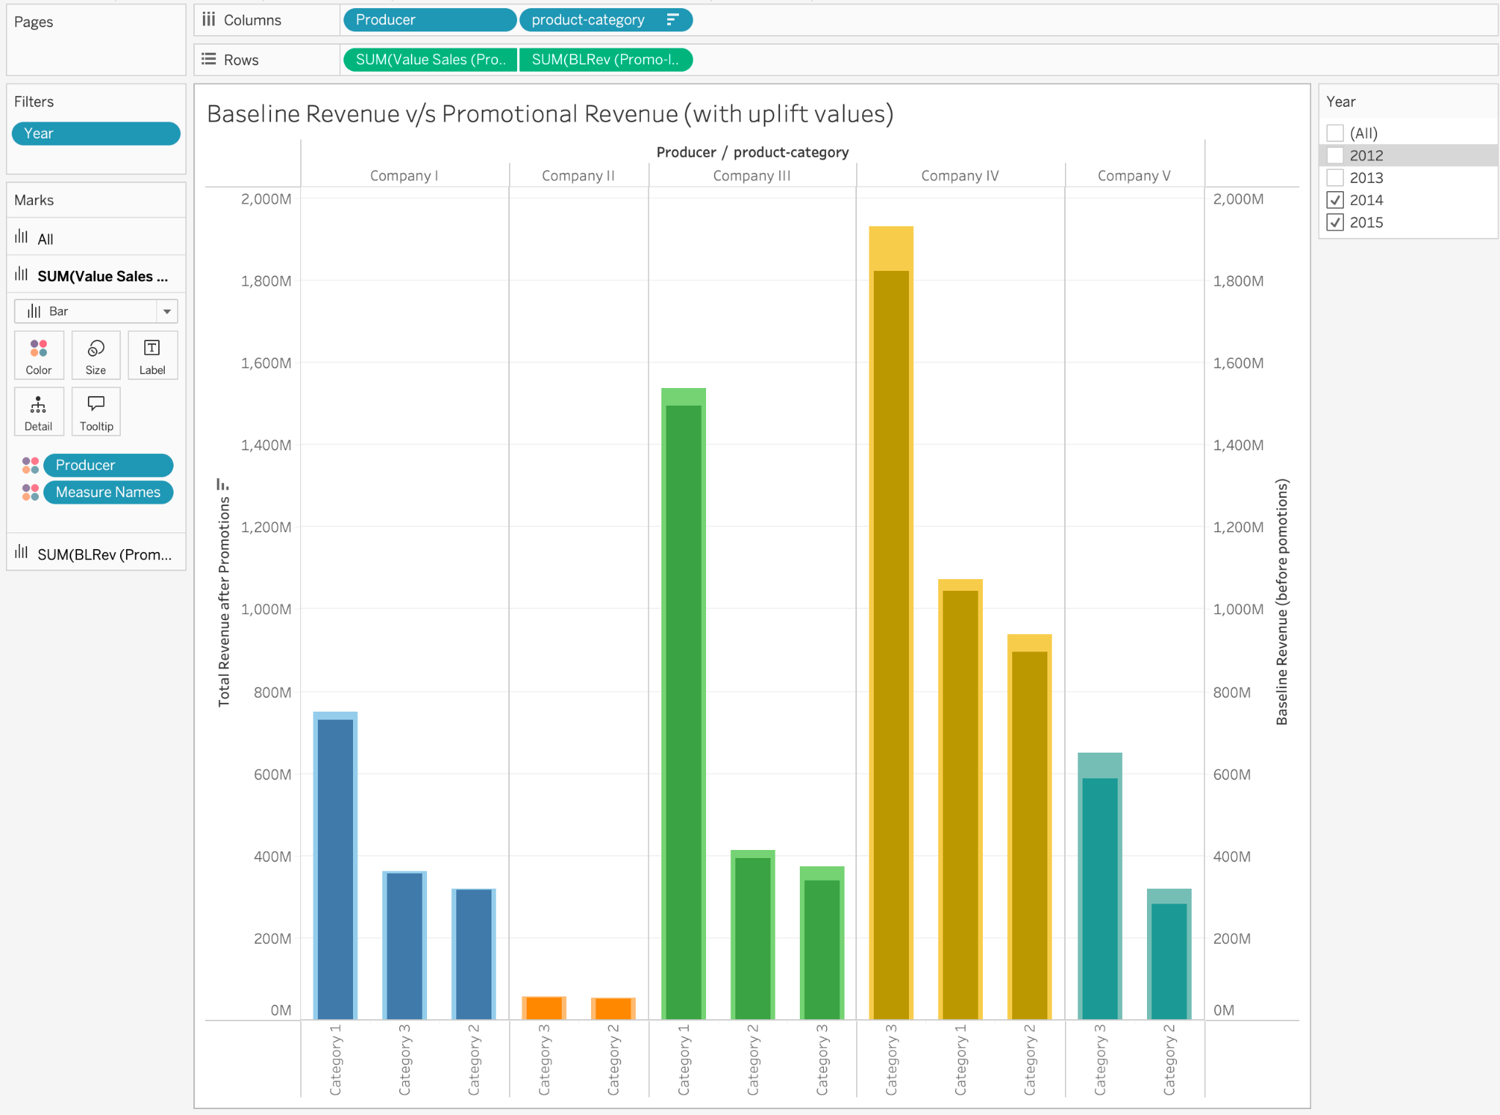
-Company 2 has least revenue out of all
-Company 4 has maximum revenue out of all of them in category
-Company 1 & 2 has no change in total revenue and Baseline revenue so their promotions making major

Slide 15
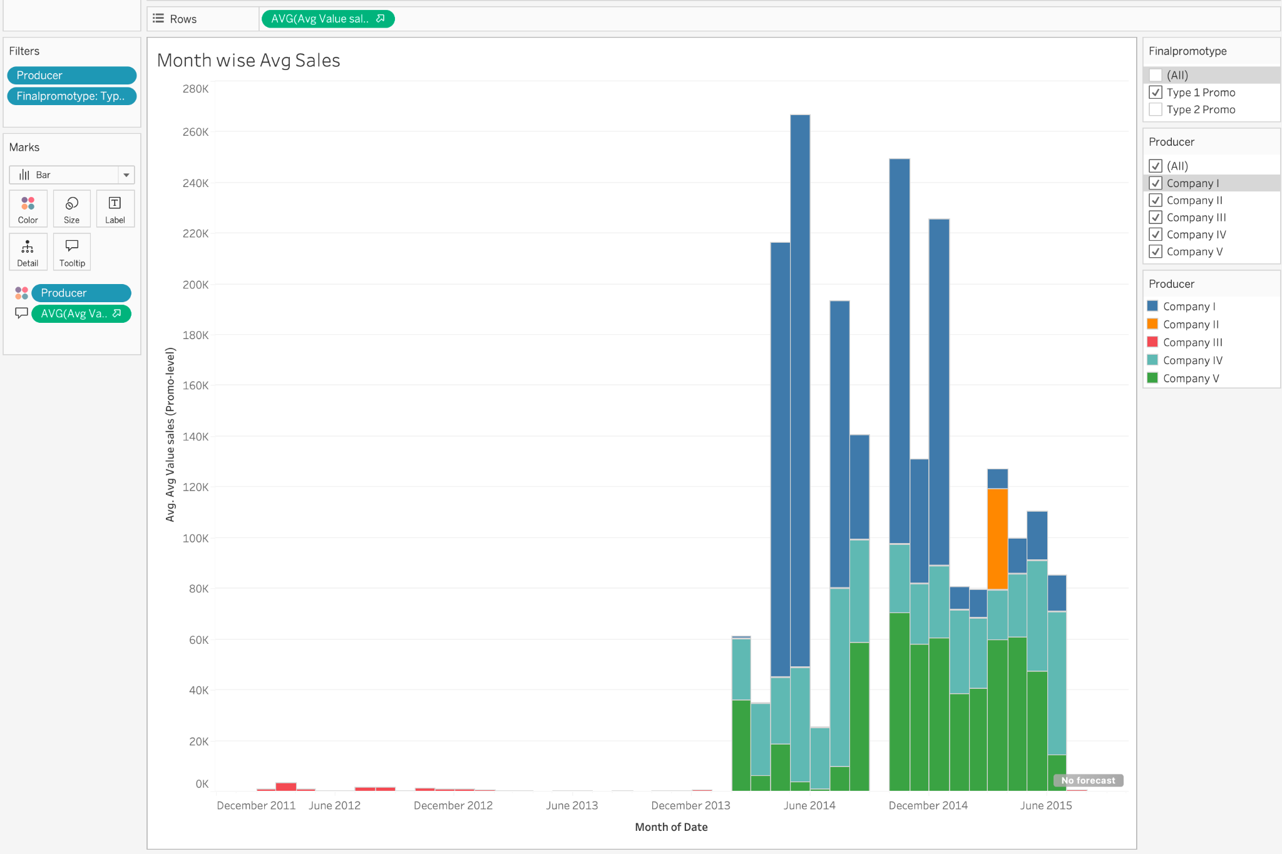
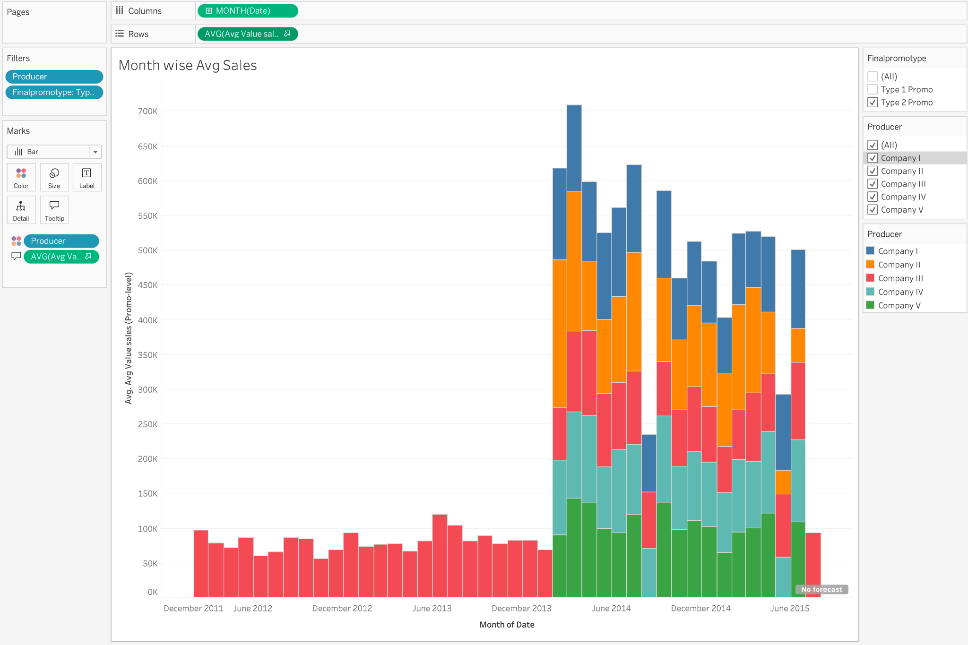
Using Type-1 promo
Using Type-2 promo
- Company 3 majorly uses Type2 promotions

Slide 16
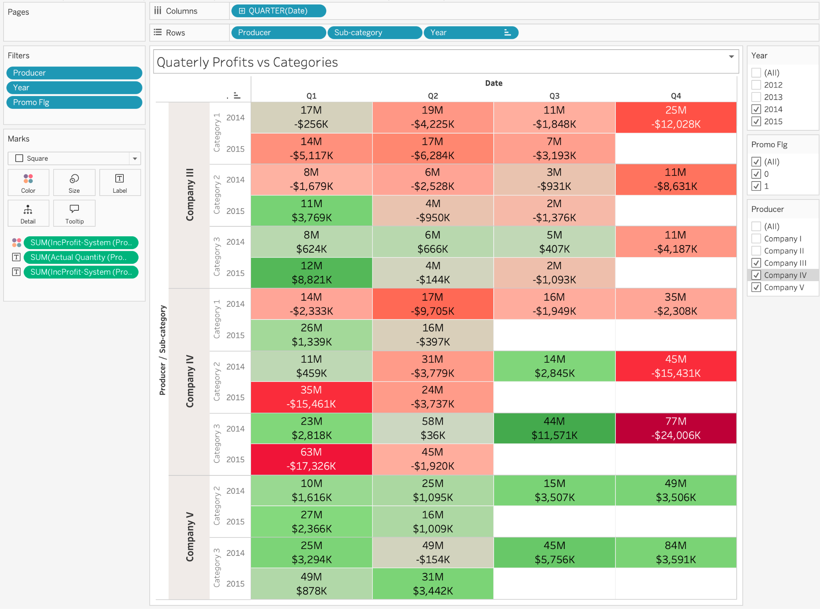
- Although company 3 did relatively well in terms of revenue, they incurred loss since 2014 Q2
- Similarly Company 4 is in loss for category 1, in category 2 & 3 they are suffering with equal loss and profits.
- Surprisingly Company 5 is doing exceptionally well in terms of profits in all the quarters although their revenue has been mediocre.

Slide 17
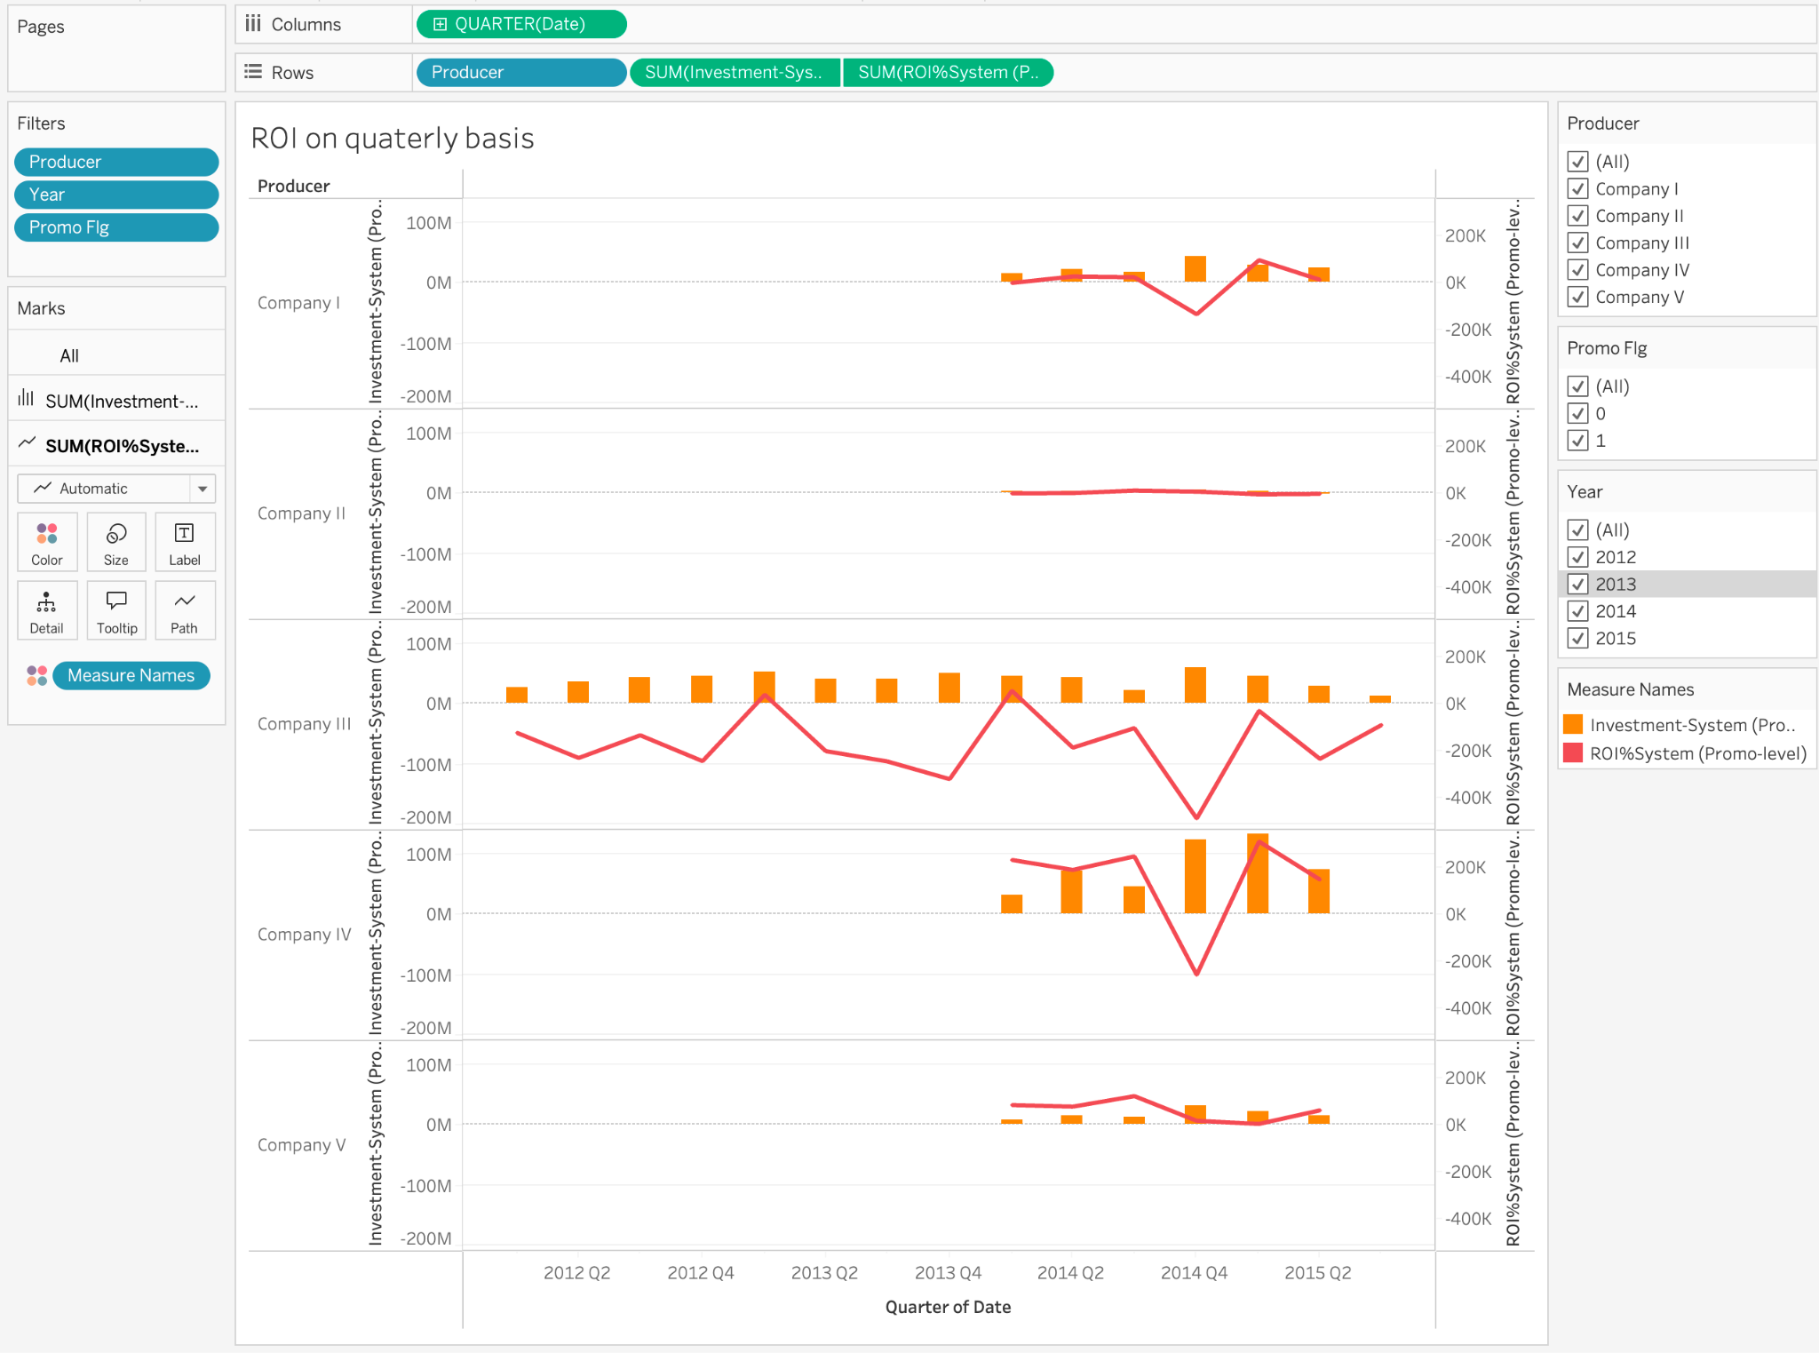
- Company 1 had major investment in Q4 but suffered in terms of ROI in the same quarter
- Out of all the companies, company 4 had the hig

Slide 18
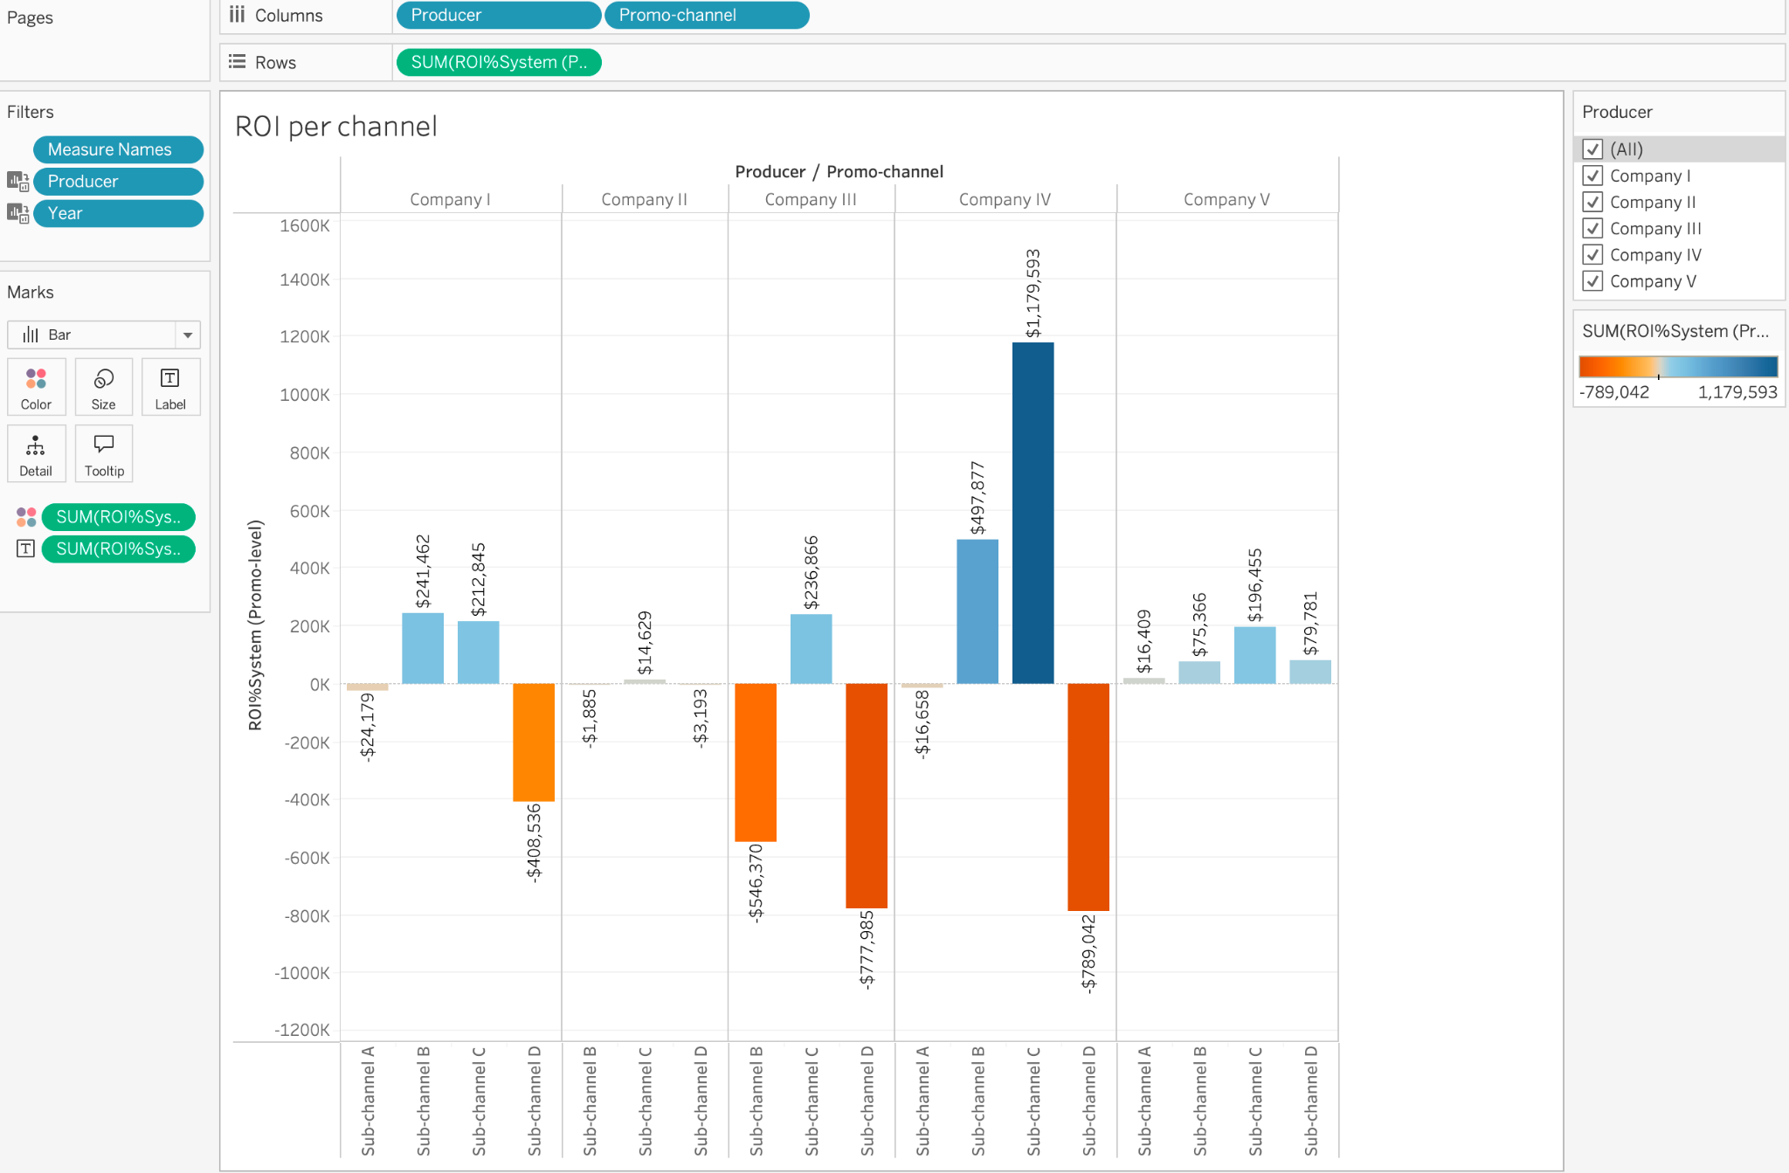
- All the companies have +ve ROI on Sub channel B
-Company 4 has highest ROI in Sub channel C
-Company 5 has +ve ROI in all Sub channels
-Company 2 has neutral ROI across all Sub channels (Not major loss or profit)

Slide 19
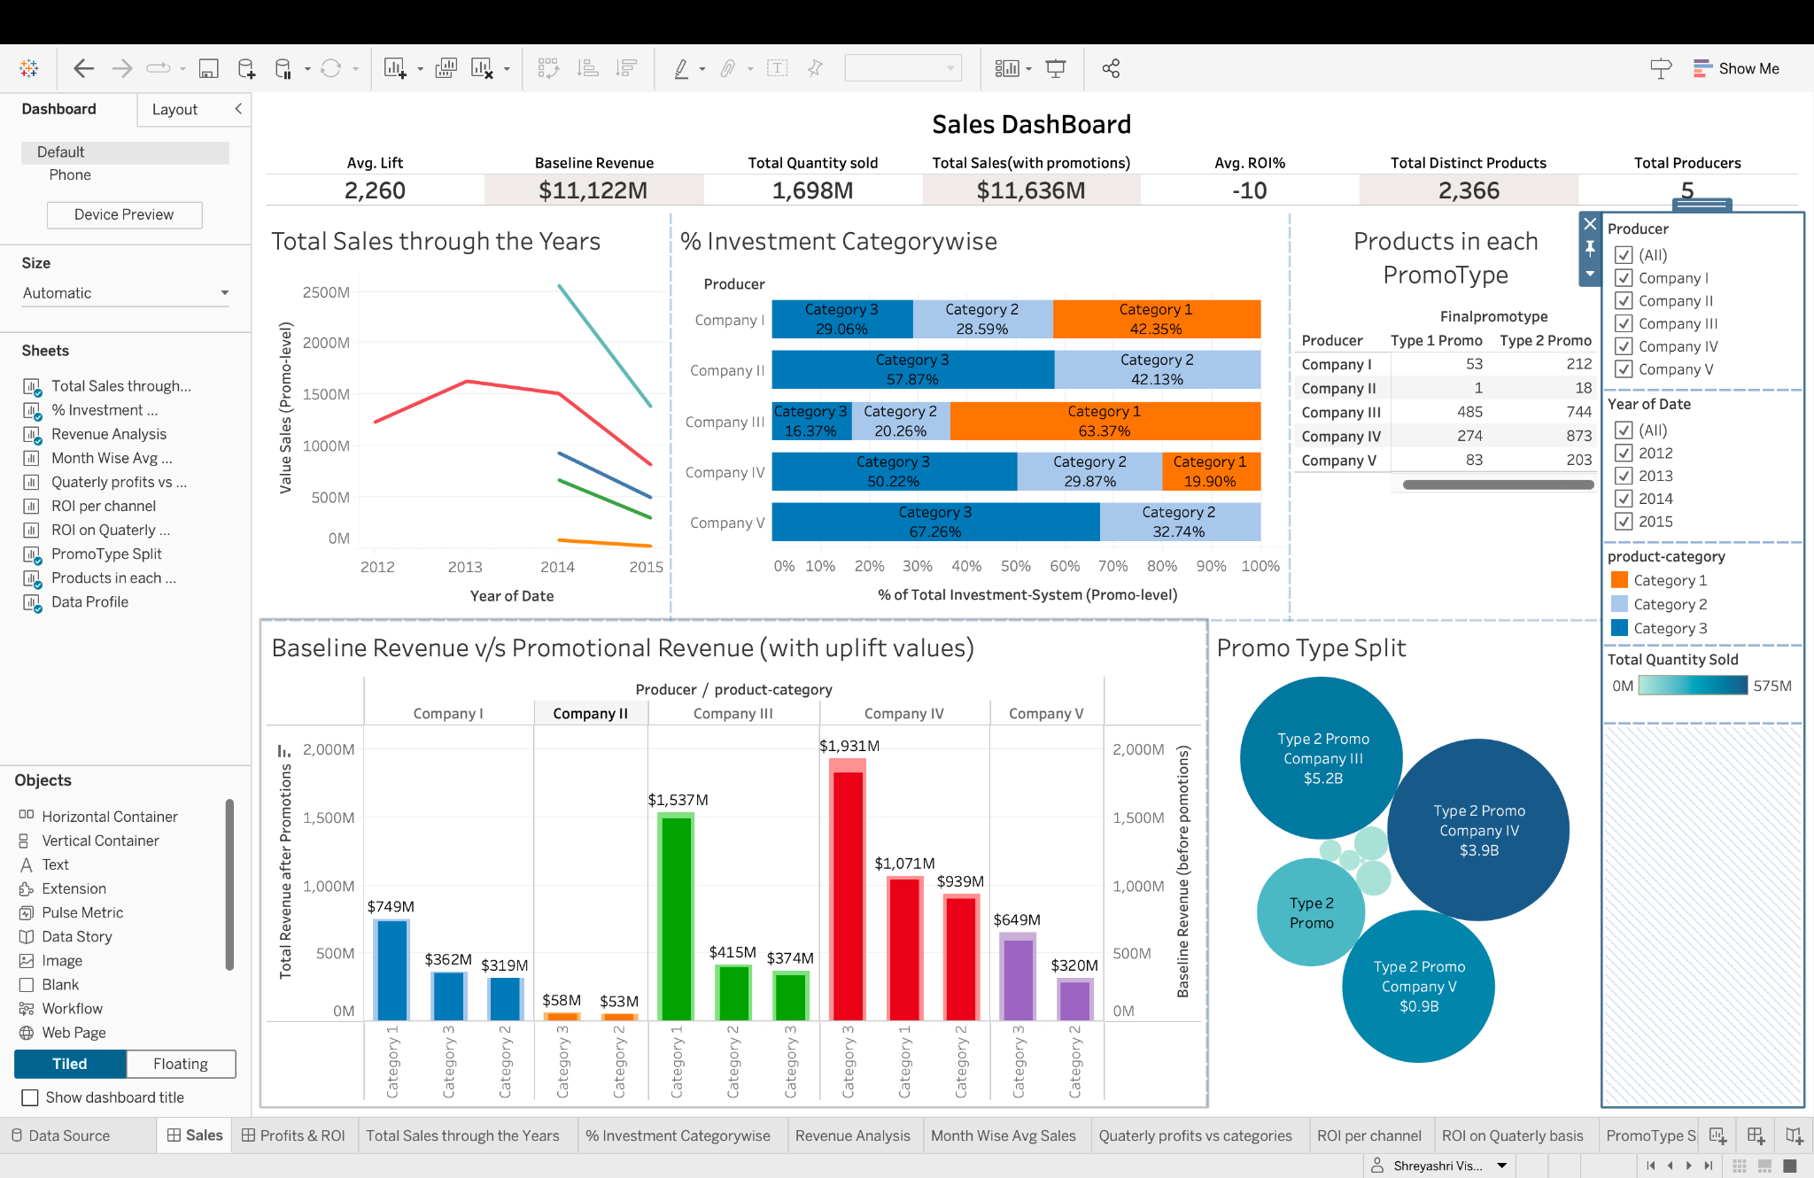
Sales Dashboard

Slide 20
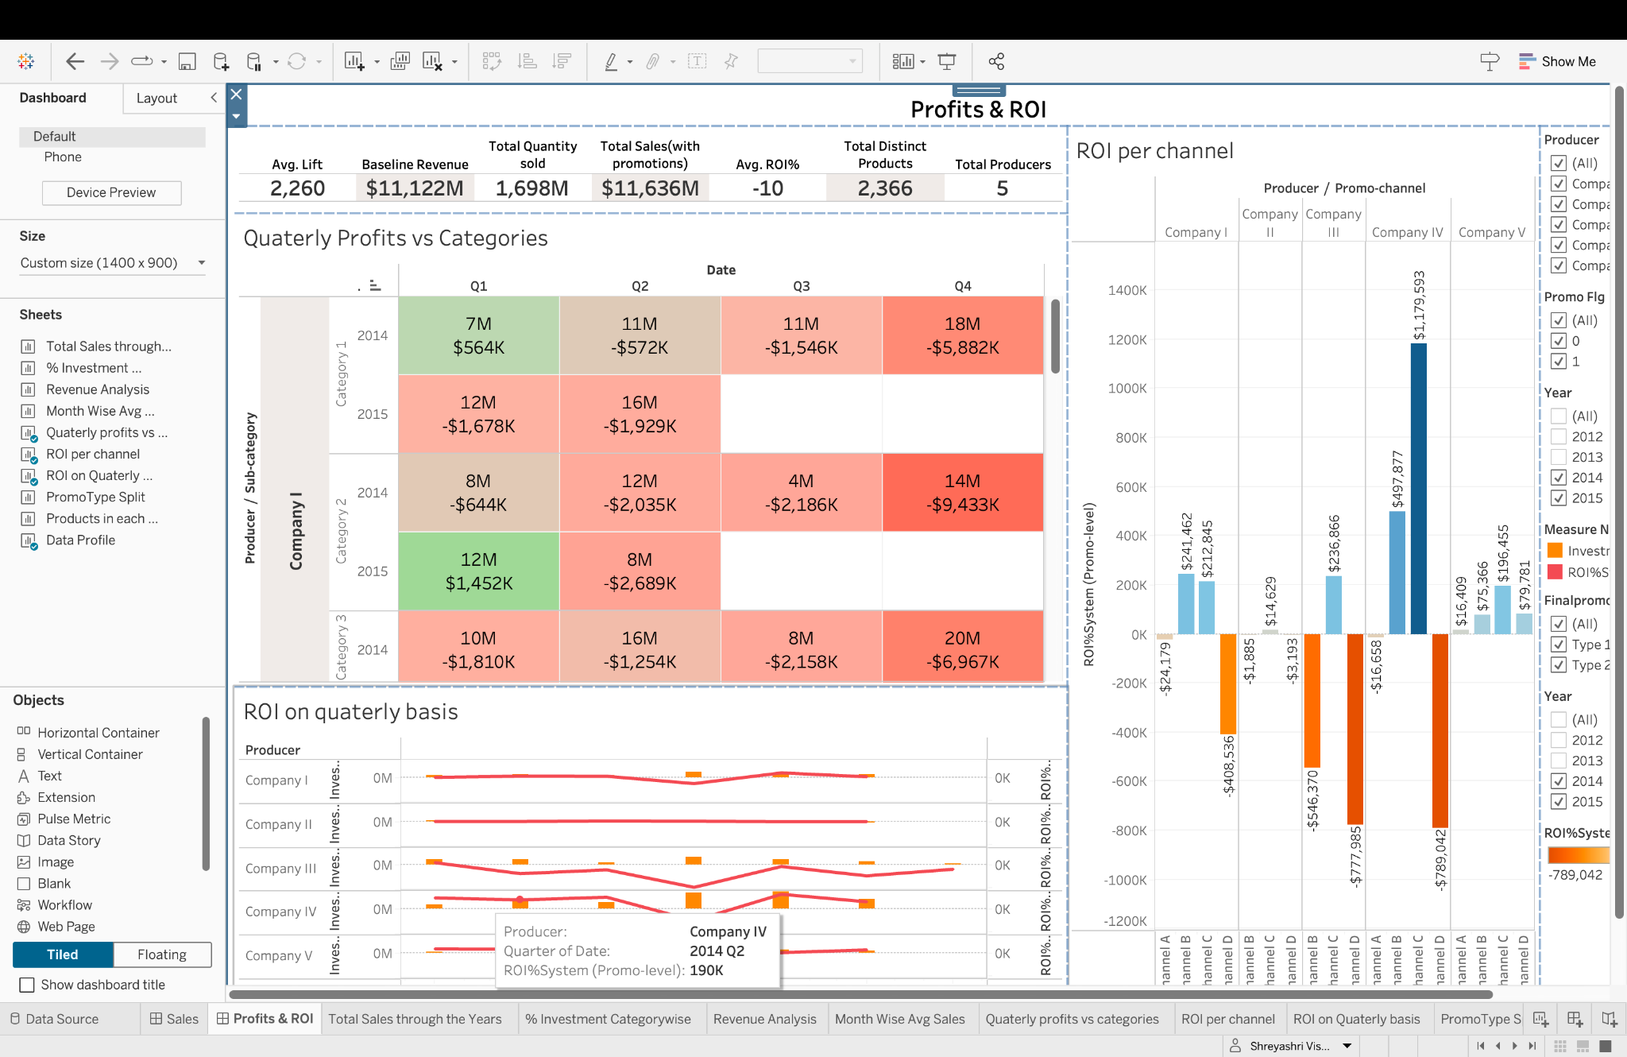
Profit&ROI Dashboard

Slide 21
Conclusion
Company 1 is a small size company with low investments and loss margins
Company 2 is also a small size company with products only in category 2,3 with less revenue and negligible profit
Company 3 has highest sales and revenue in all categories but suffering drastic loss as compared to other companies. It is also the only company that has been doing business since 2012
Company 4 also relatively high sales and revenue with quarterly losses and profits.
Company 5 although doesn’t have huge sales or revenue but has consistently bagged profits in all quarters across category 2,3

Slide 22
Recommendations
If an angel investor is investing in one of these companies, for profitable returns we recommend:
Safe choice
Company 5 in Category 3, 2 under Sub channel C in type 2 promotions
Risky choice
Company 2 in Category 2 in type 2 promotions

